Slide 1
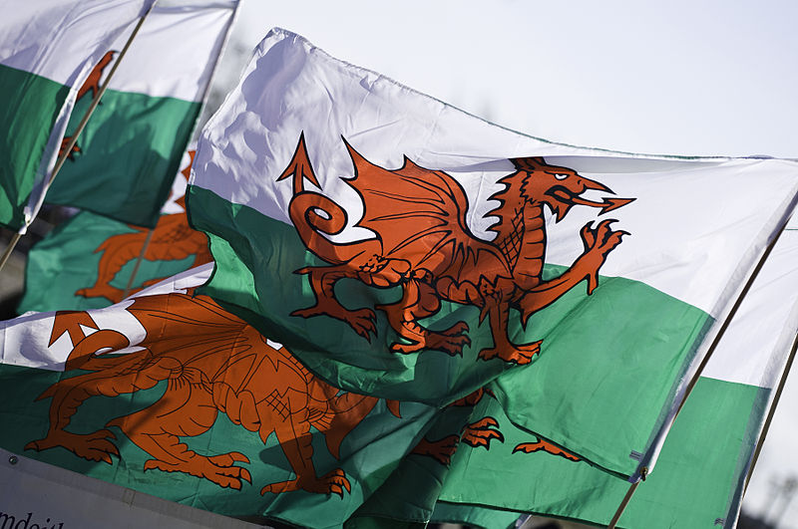
Part 4: Wales vs. ‘England and Wales’

Slide 2
Contents
1. Historical Reminders
2. Economic Characteristics Today
3. Political Devolution
M. Bourdeau UJML3 2020-2021

Slide 3
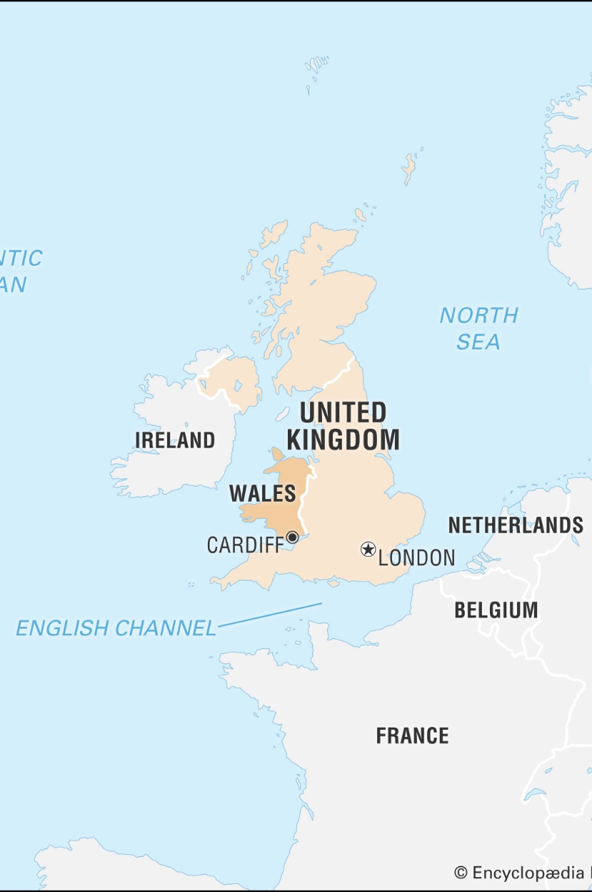


Basic facts about Wales
Capital: Cardiff
Population: 3 million (2016)
Languages: English and Welsh
M. Bourdeau UJML3 2020-2021

Slide 4
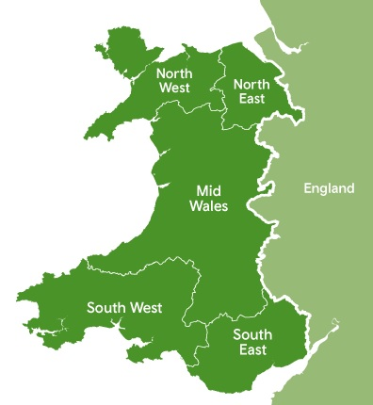
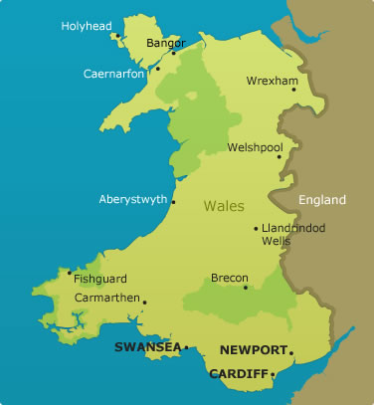
Geography
M. Bourdeau UJML3 2020-2021

Slide 5
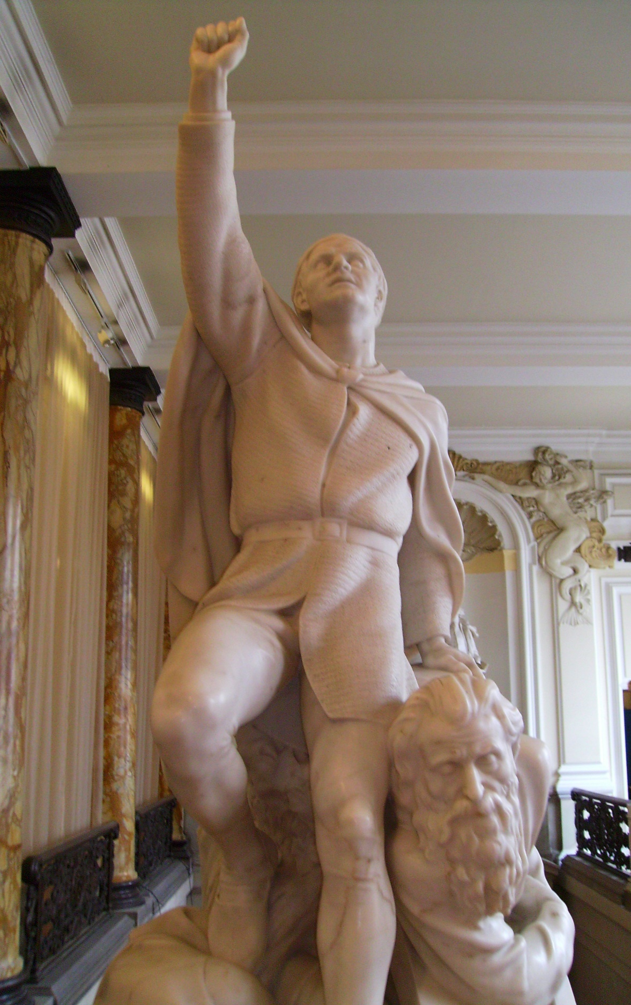
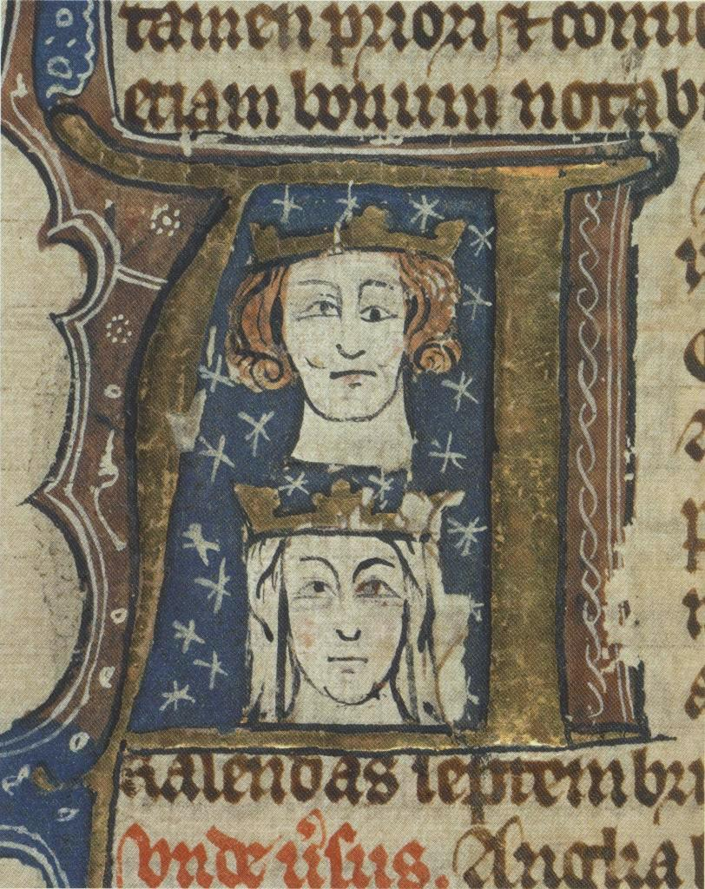
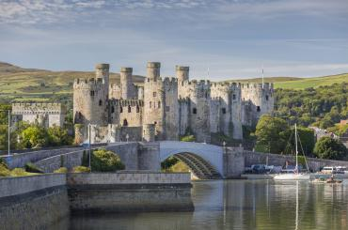
1. Historical Reminders
Middle Ages: autonomous region
Edward I (1272-1307)
Conquest (against Llywen ap Gruffyd)
Built castles to assert domination
1282: Rebellion crushed
1284: Statute of Rhuddlan
Annexation of Wales
1536: Act of Union
Same law
Same Parliament (26 MPs)
Same language
M. Bourdeau UJML3 2020-2021

Slide 6
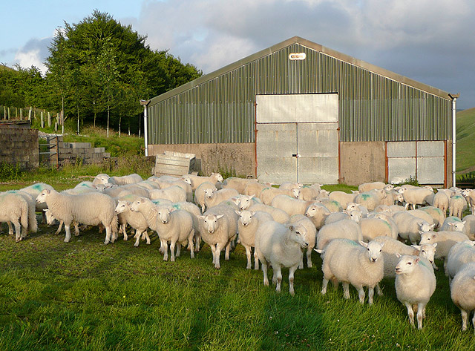
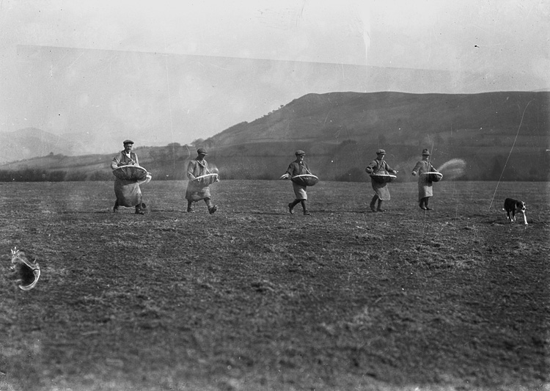

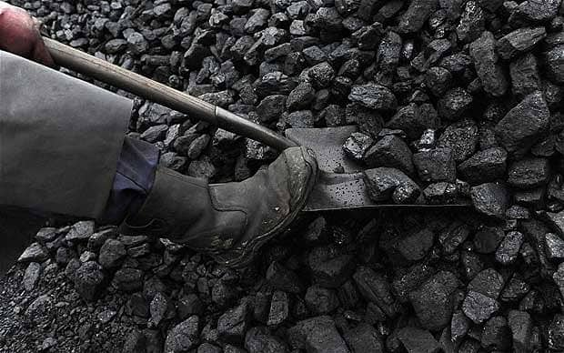
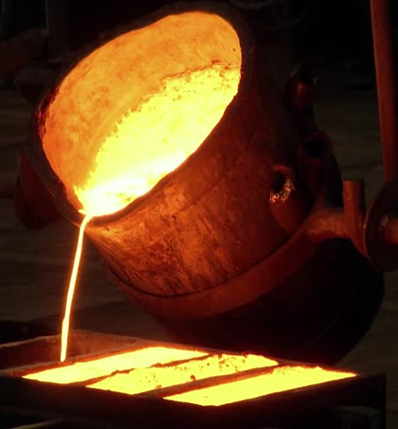
Economic activities:
first farming
then diversification
M. Bourdeau UJML3 2020-2021
Farming
Lead-mining
Coal-mining
Iron Smelting

Slide 7
Industrial take-off
2nd half of the 18th /early 19th: lots of wars
American War of Independence
French Revolutionary & Napoleonic Wars
etc
Great need for industrial goods (metal, fuel etc)
Wales had the natural resources and developed the necessary infrastructures
By 1851:
2/3 of Welsh families’ living depended on the industry
Wales = World's second industrial nation after England
M. Bourdeau UJML3 2020-2021

Slide 8
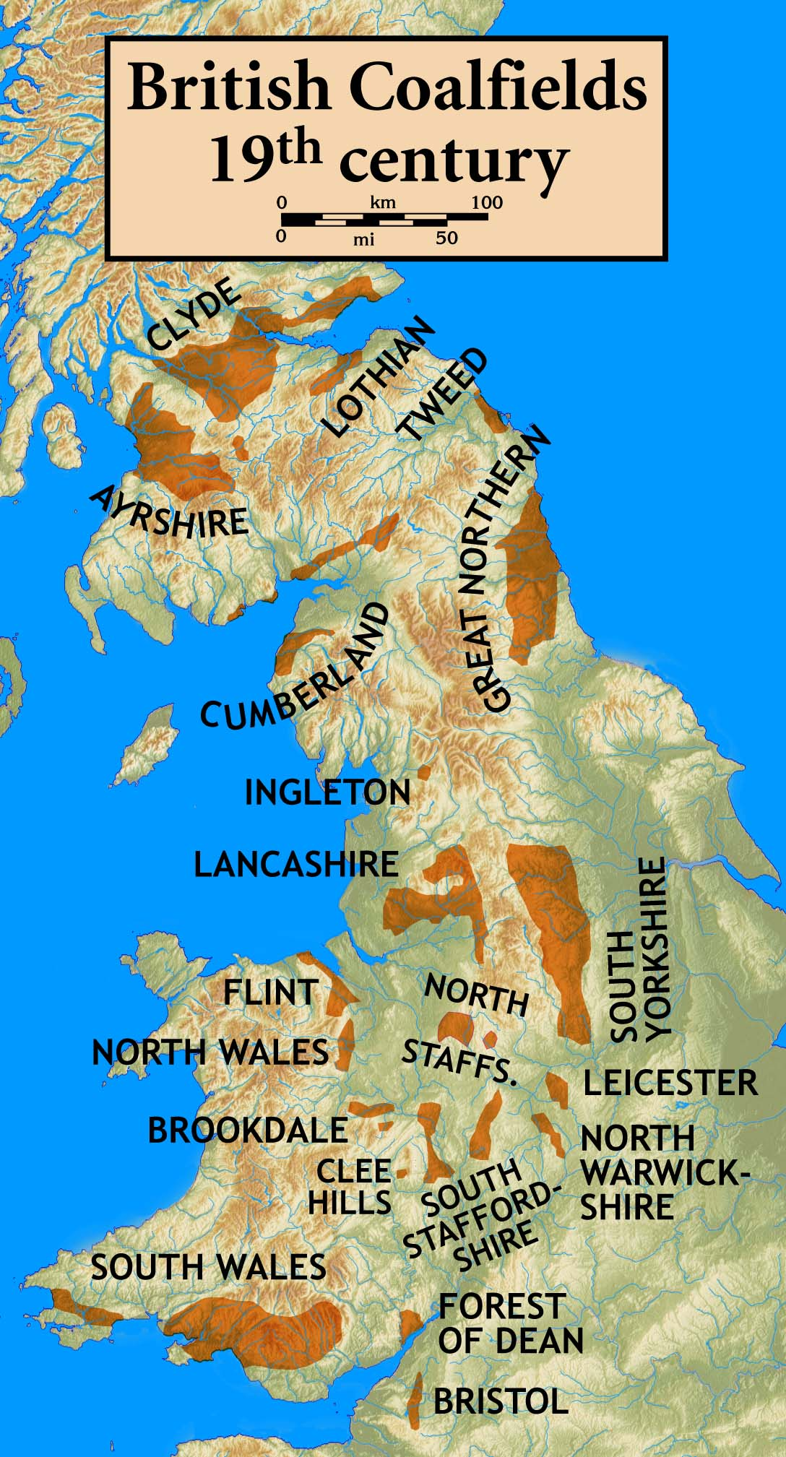
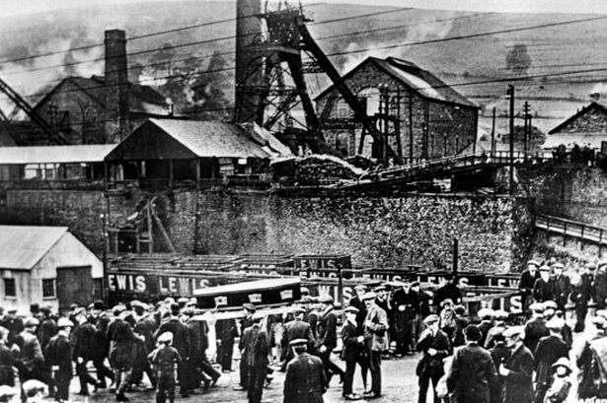
Industrial activity
Coalmining (North East + mostly South)
Migration to South Wales
M. Bourdeau UJML3 2020-2021

Slide 9
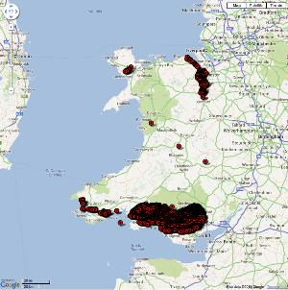
Coal production
peak in 1913 but non-sustainable
(war demands)
Decline
increased coal production elsewhere
transition to oil
Post-war mismanagement
=> collapse in 1921
Unemployment for miners:
April 1924: 2%
January 1925: 12.5%
September 1925: 28.5%
Huge economic/social /cultural impact
M. Bourdeau UJML3 2020-2021

Slide 10
Wall Street crash of 1929:
Steel and transport workers
Agriculture also hit hard
1932-33= end of depression BUT also end of the industrial growth
Massive emigration:
1925-1939: 390,000 people
1973: back to the 1925 demographic level
1945
Still low standard of living
Coal and steel industries = 30% of the Welsh male workforce
Agriculture = 10% (WWII= Food shortages => increase in prices => prosperous agriculture)
Late 20th century: Coal industry almost completely vanished
M. Bourdeau UJML3 2020-2021

Slide 11
2. Economic Characteristics Today
So-far vain efforts to replace/create jobs in former mining areas
Regional level: Wealth gap (recently widening further)
National level: Among the poorest regions of the UK with Northern Ireland and the North East of England
GVA (Gross Value Added) : lowest level in the UK (exception: Cardiff, more dynamic than even London!)
Anglesey
GVA: only around half the UK figure
Closure of Anglesey Aluminium in 2009
South Wales Valleys:
Poorest region
Erosion of jobs
M. Bourdeau UJML3 2020-2021

Slide 12
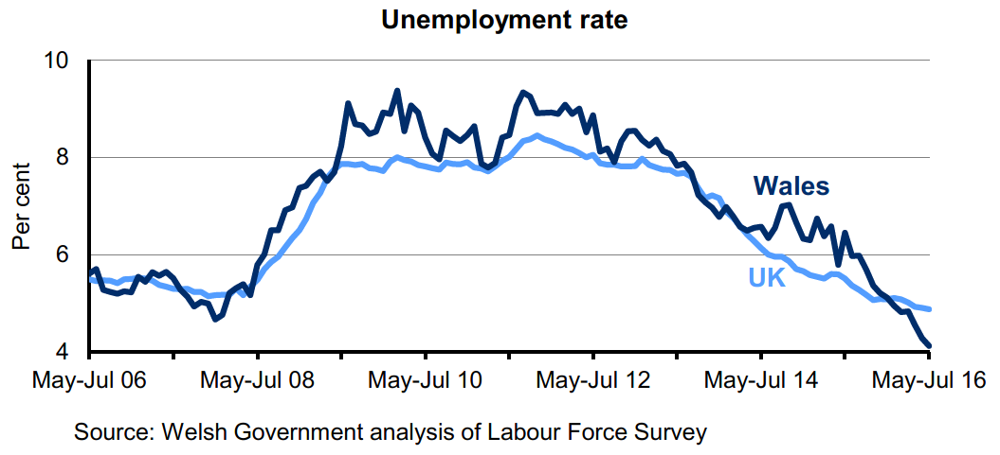
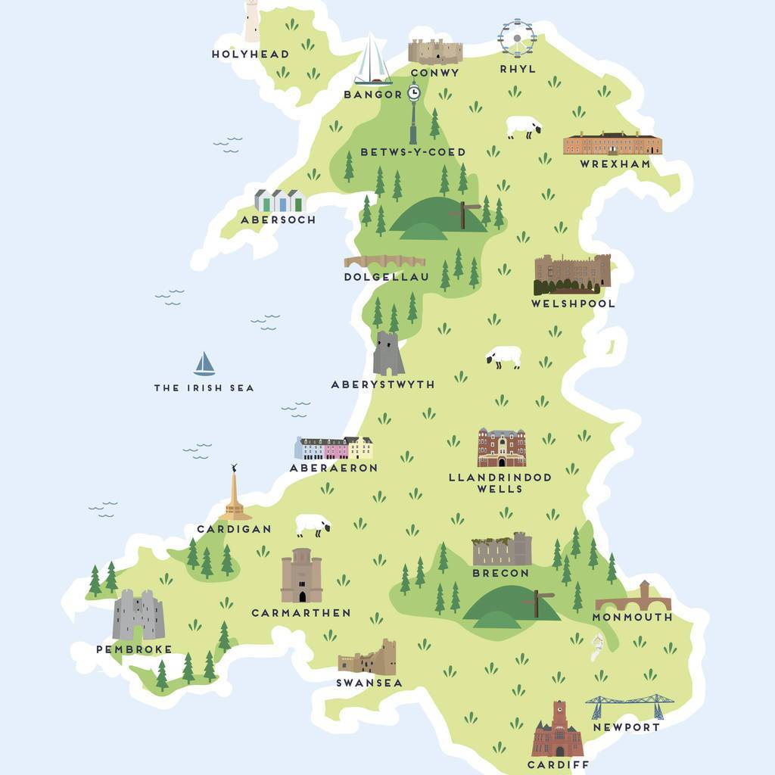
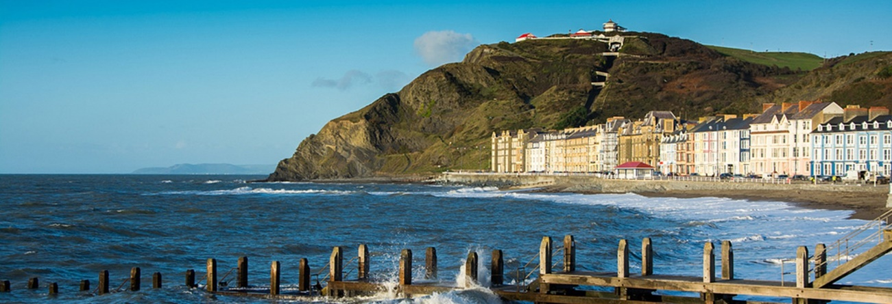
REASONS FOR HOPE:
Unemployment rate:
consistent decrease
4.1% (July 2016)
vs.
3.9 (August 2019)
M. Bourdeau UJML3 2020-2021
Aberystwyth (cultural capital)
25% growth in population
National Library of Wales
Aberystwyth University
Current focus: services and tourism

Slide 13
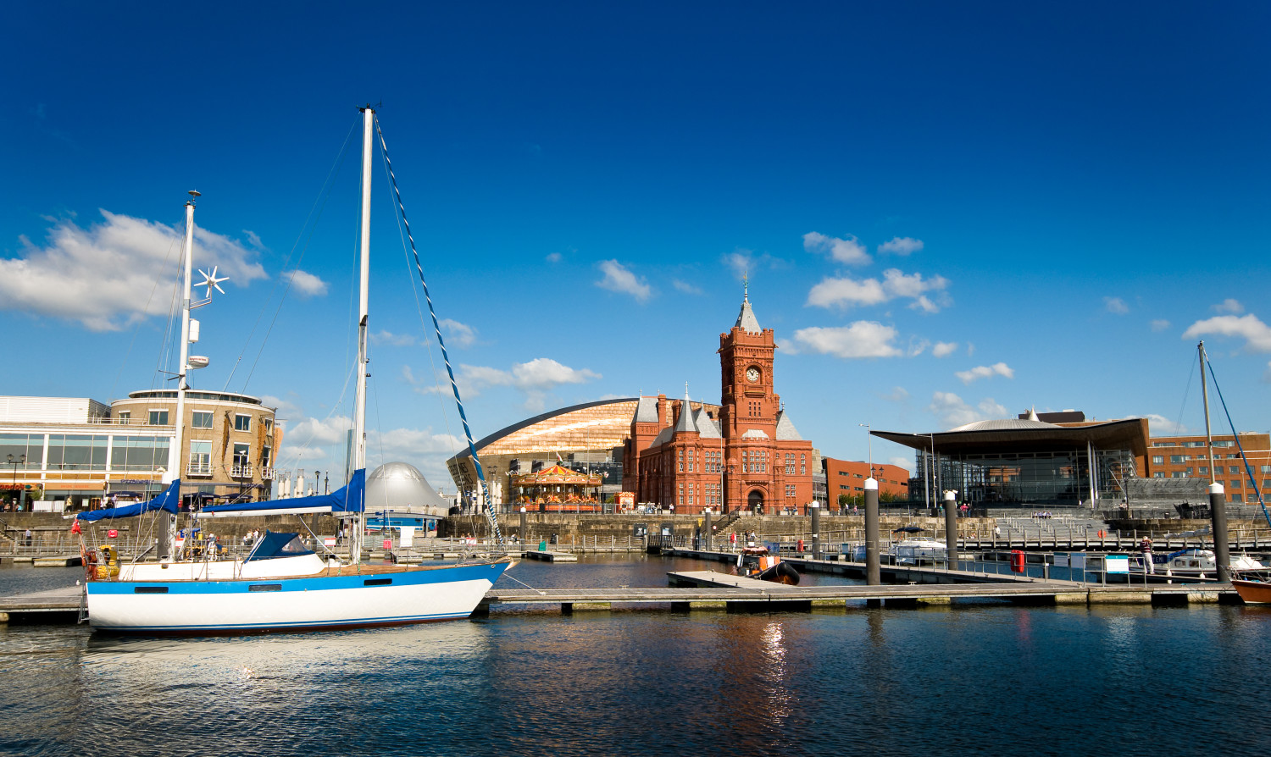
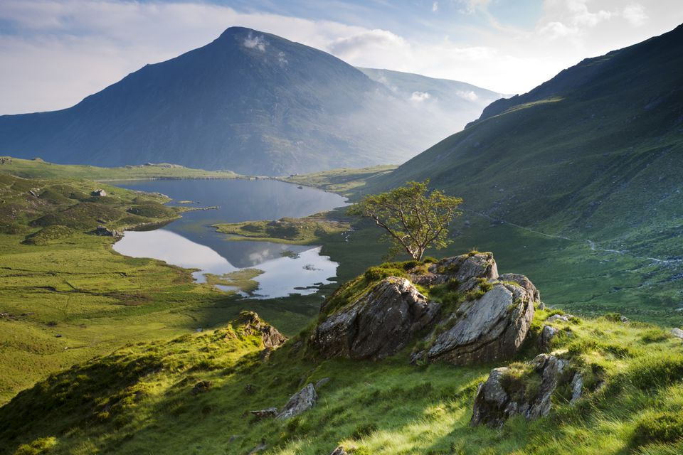

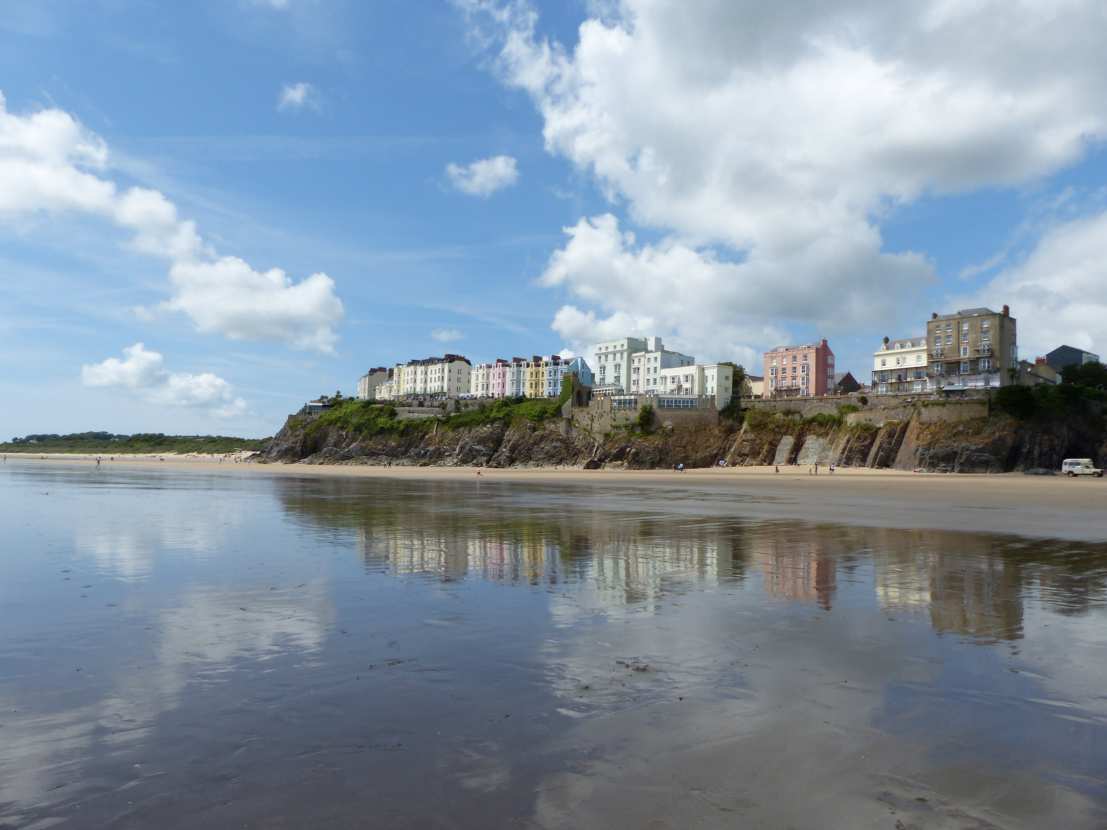
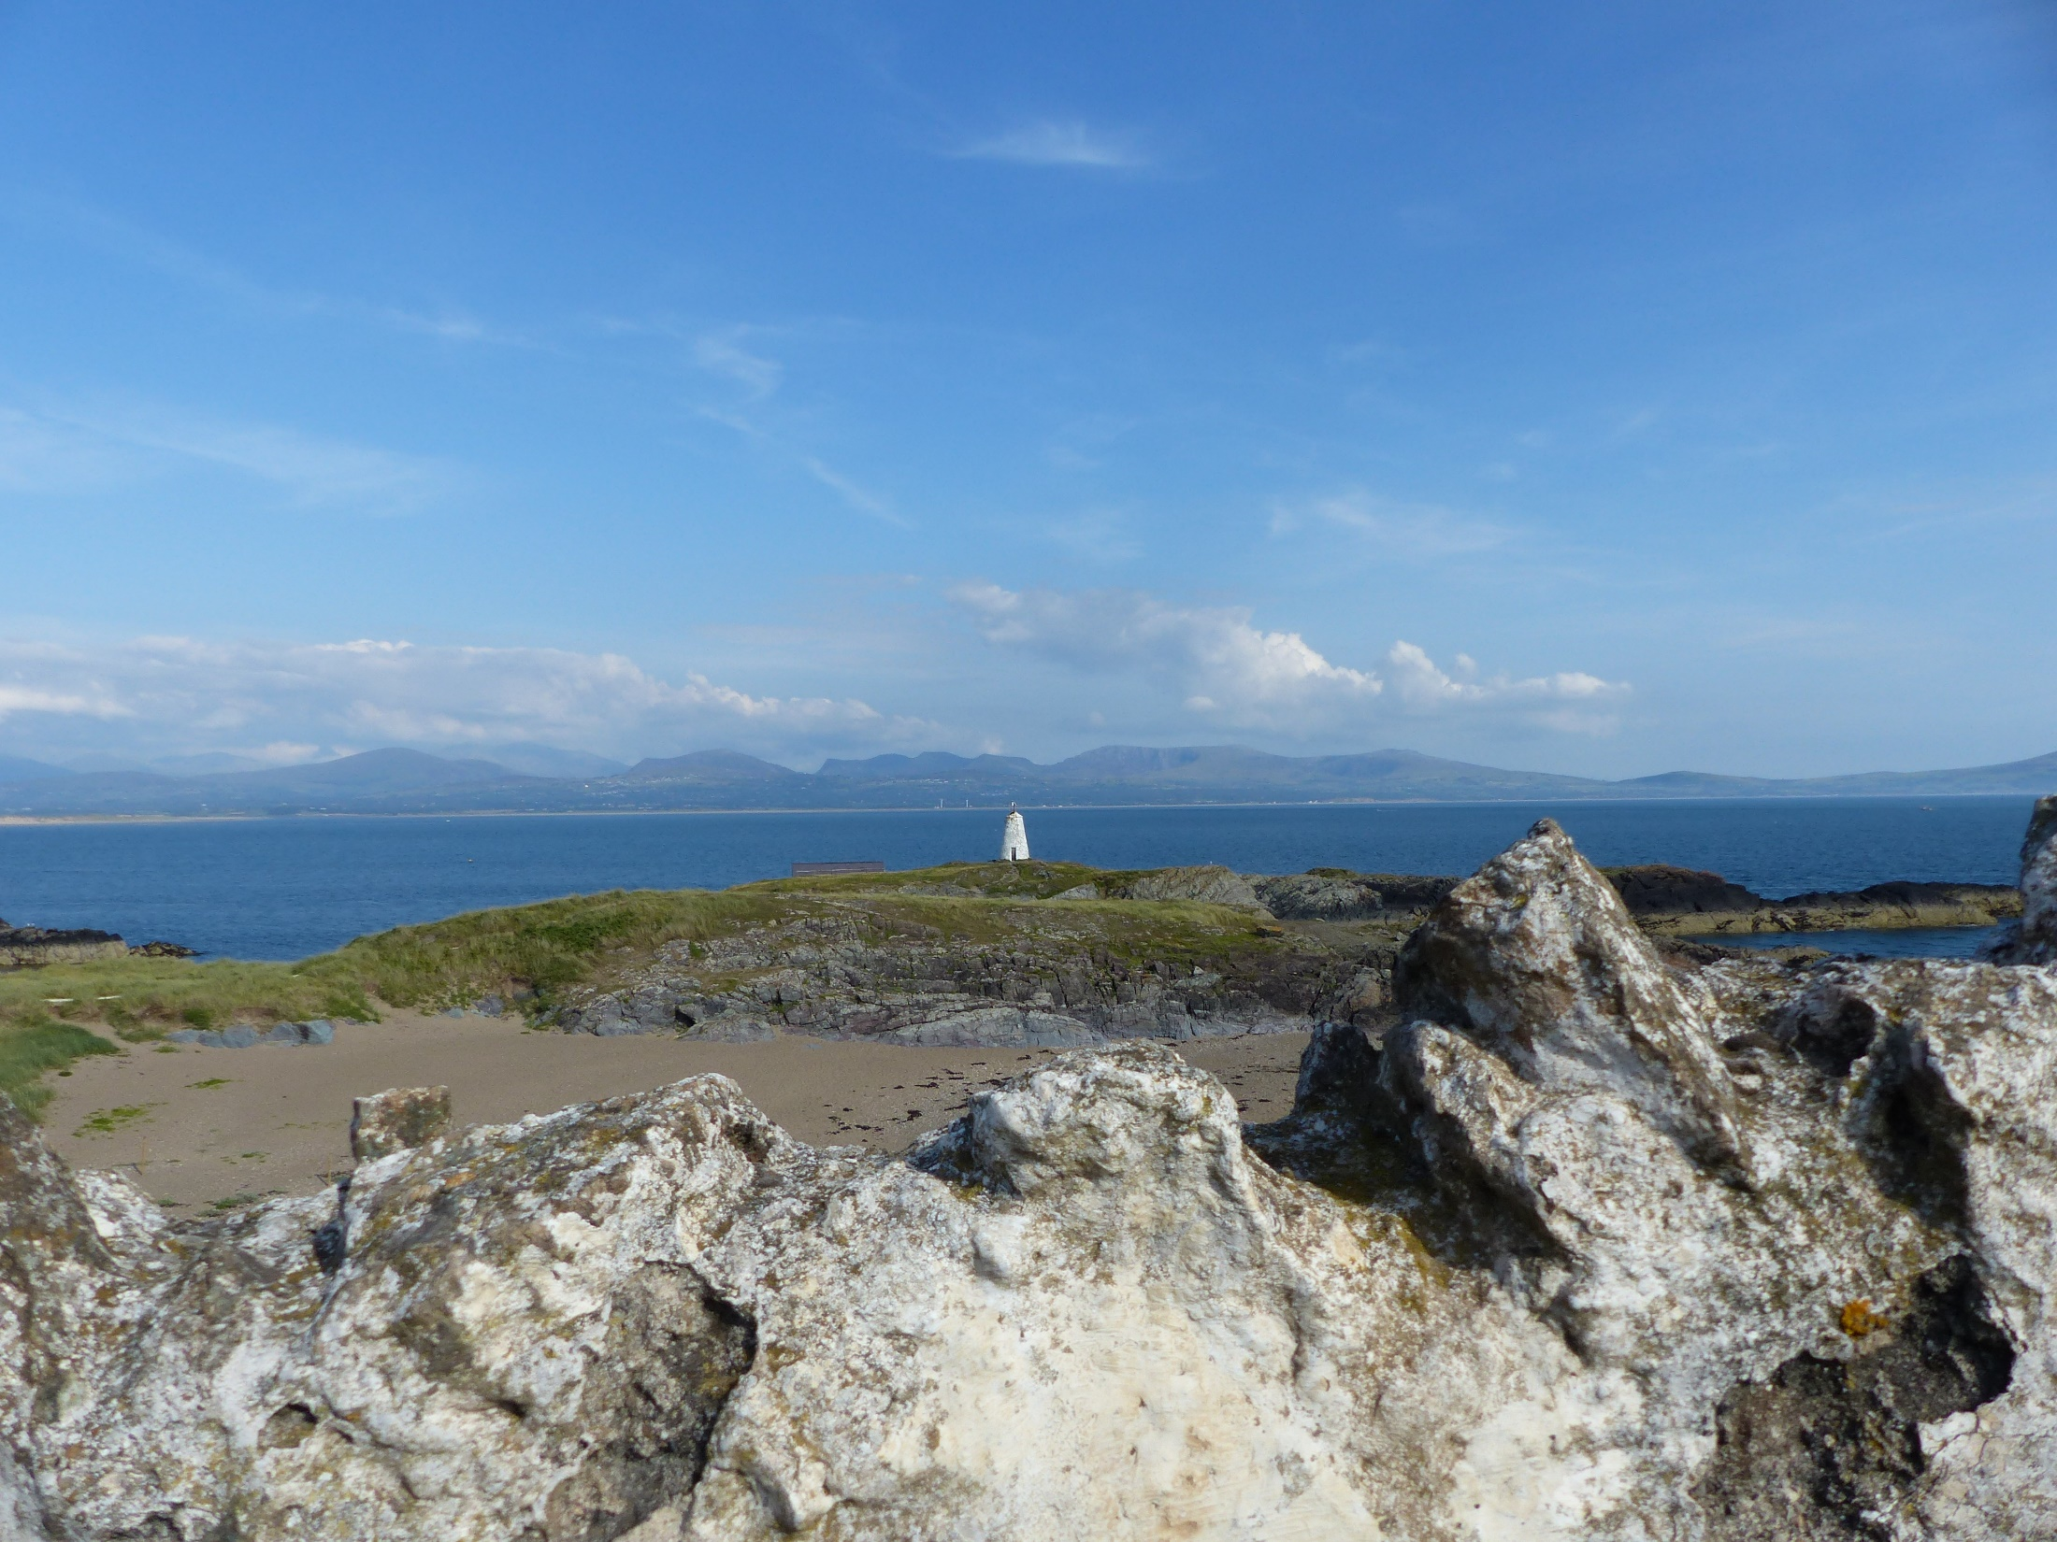
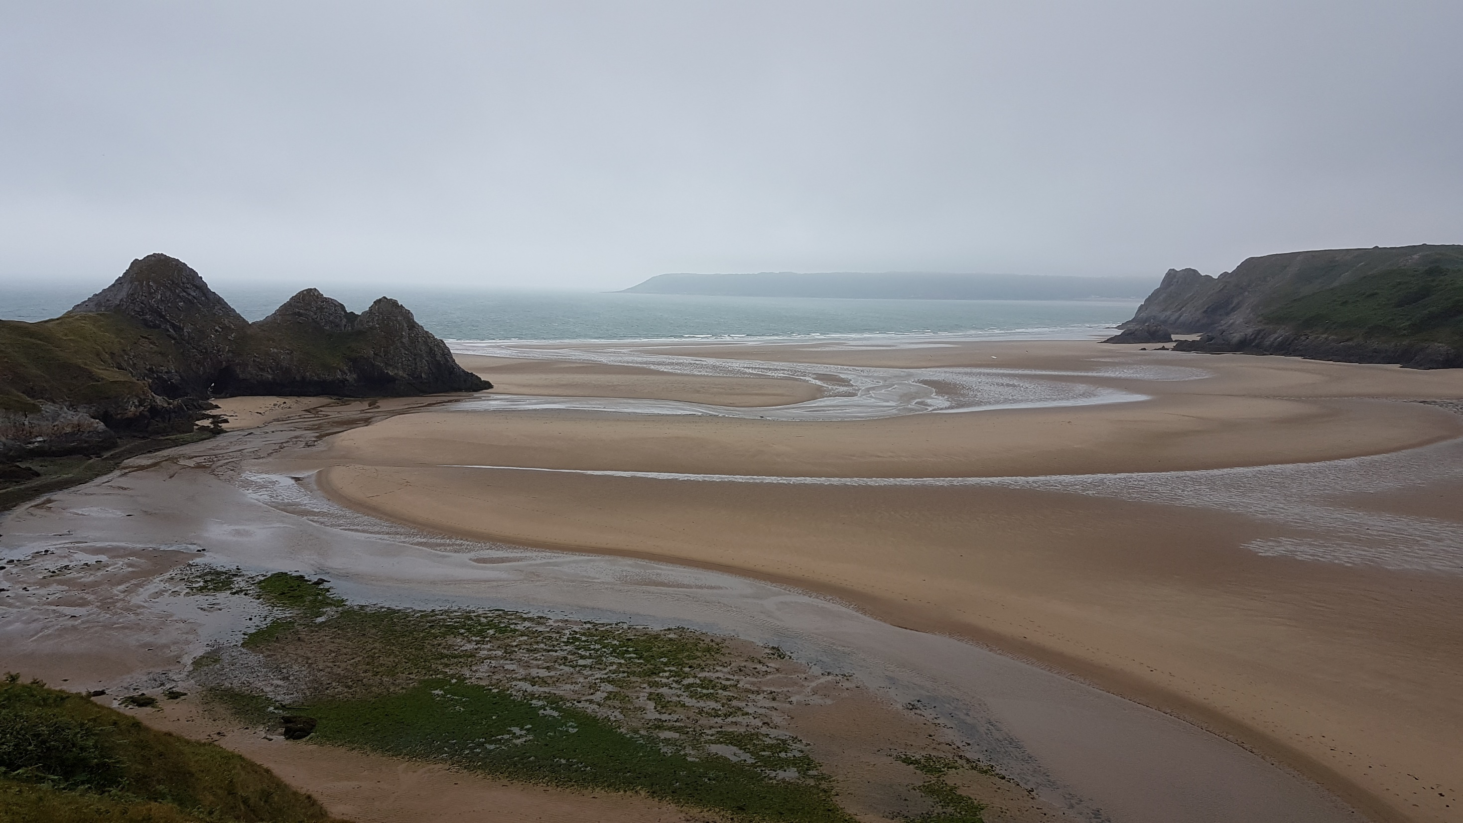
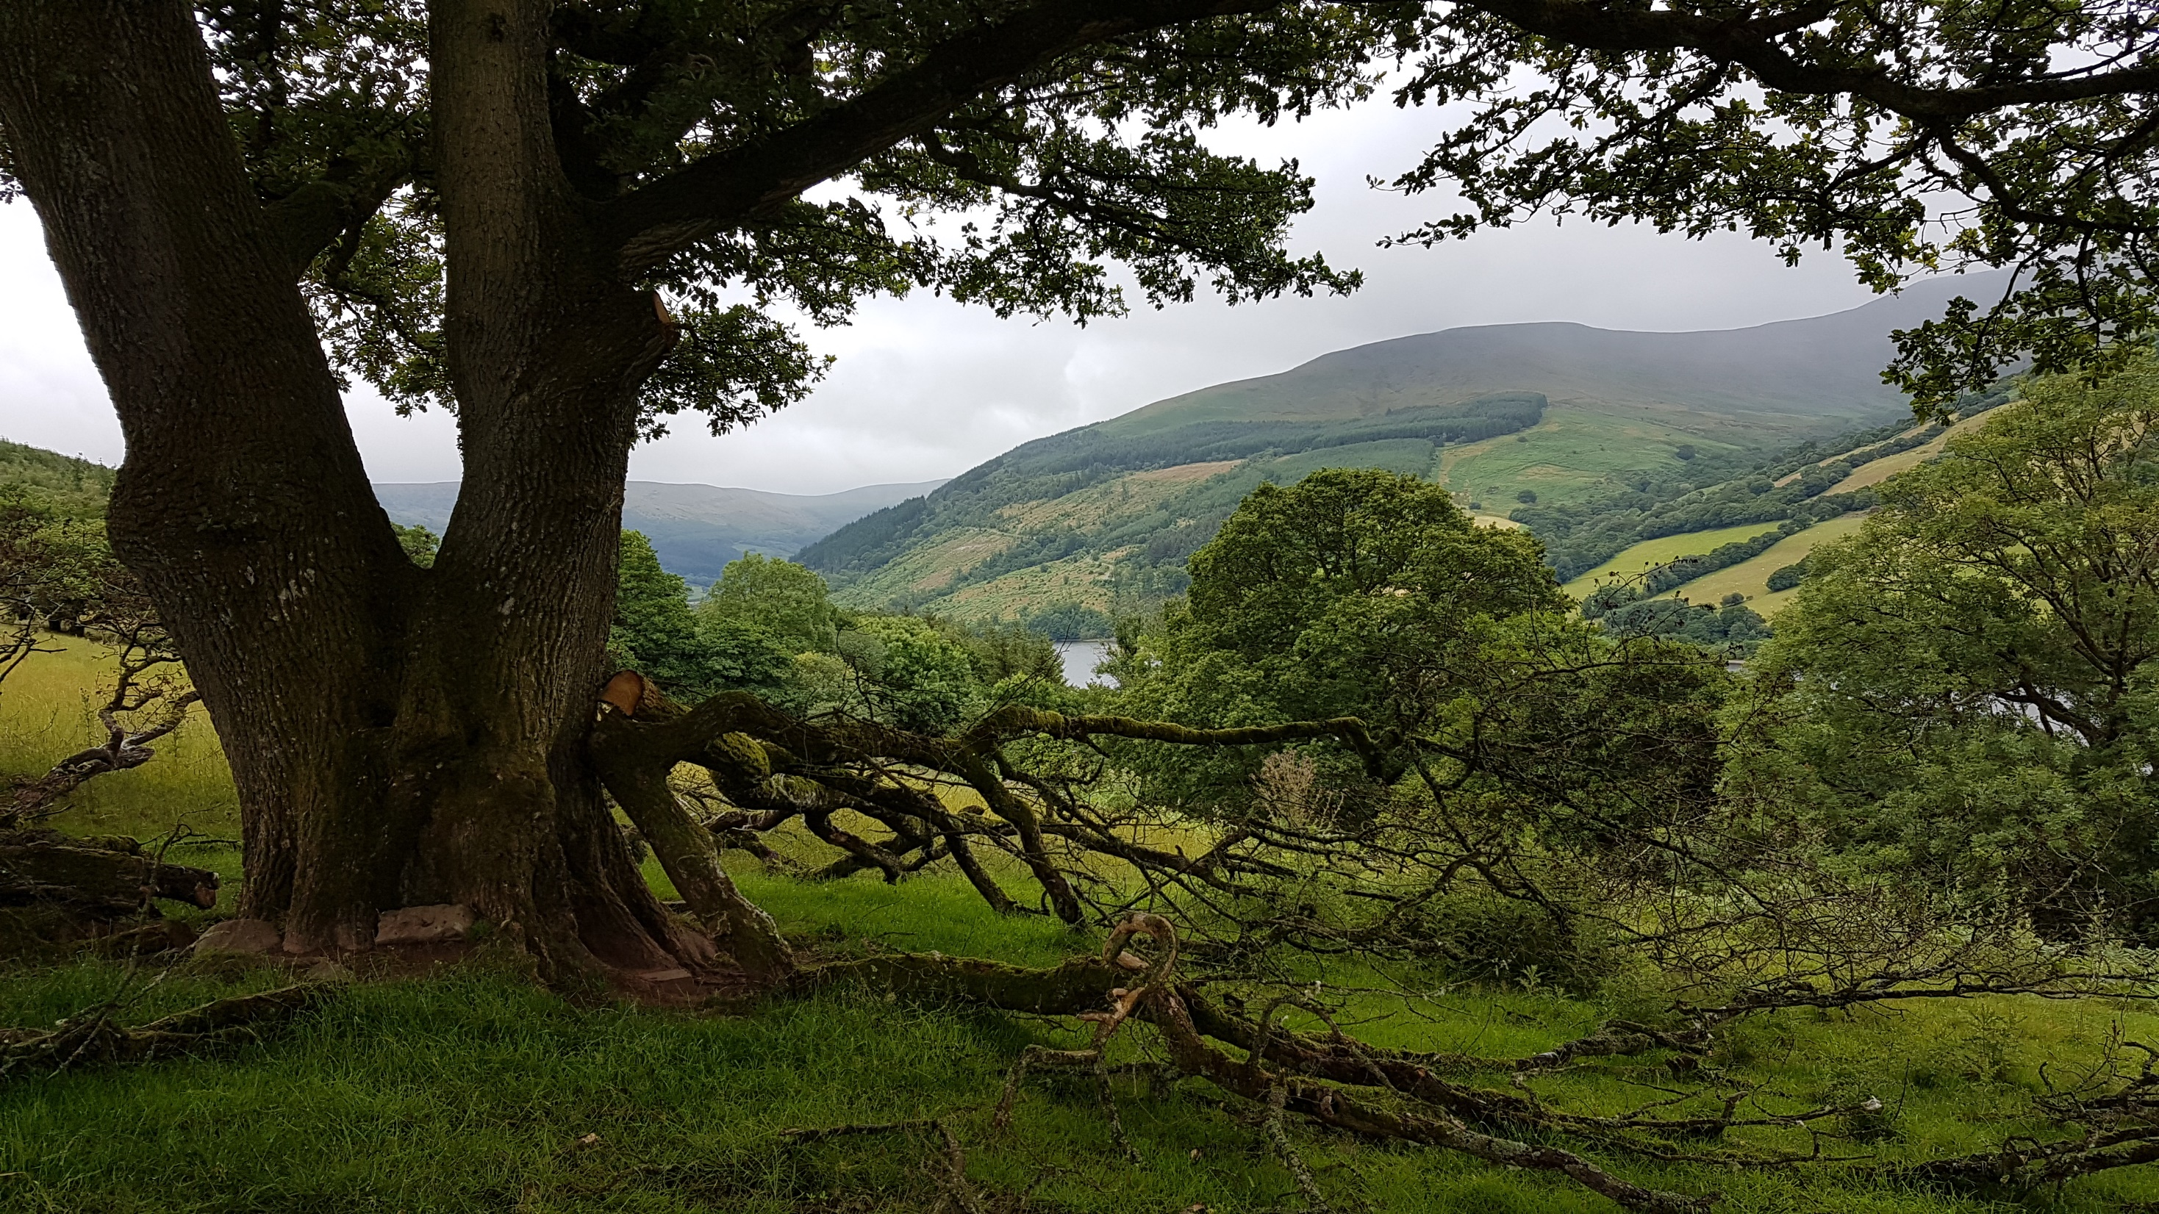
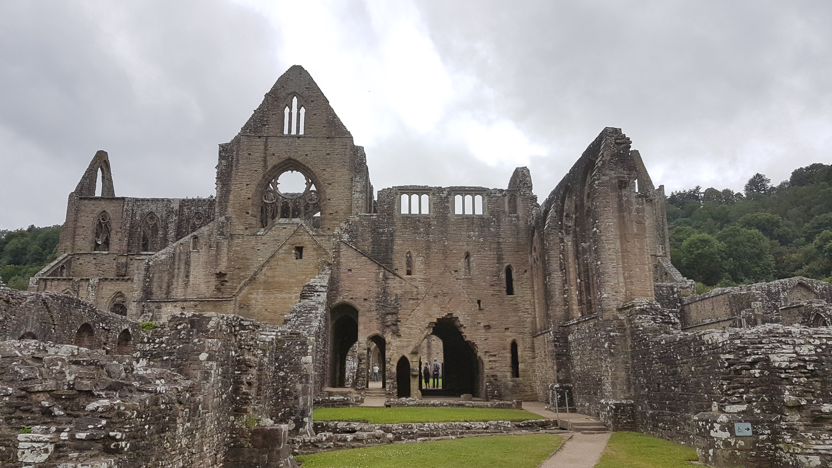
Tourism
Snowdonia
National Park
Tintern Abbey
Pembrokeshire
Ynys Llanddwyn, Anglesey
M. Bourdeau UJML3 2020-2021
Brecon Beacons
National Park
Tenby,
Pembrokeshire
Gowan Peninsula

Slide 14
Booming sectors
Tourism =
Outdoor activities
National Parks
City tourism
3 billion pounds /year
Job creation
= major area of employment growth and investment
Cultural & creation industries :
2006= 17,500 employees; revenue: £400 million/year
Today= 40,000 jobs.
M. Bourdeau UJML3 2020-2021

Slide 15
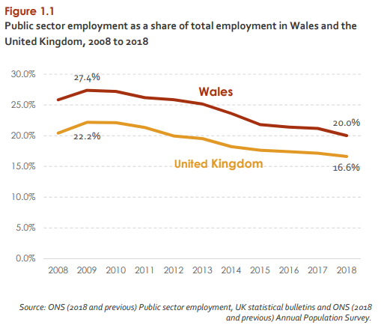
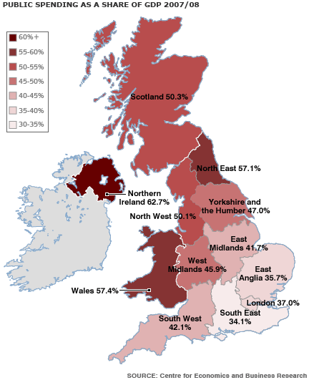
Public sector
• Health, education, and government
• 60% of the economy
• 2009: 27.4% of the Welsh workforce BUT austerity cuts =>
2018: 20.0%)
M. Bourdeau UJML3 2020-2021

Slide 16
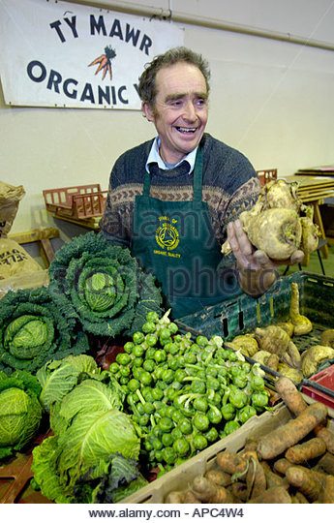
Private sector
Resurgence of small, local businesses (ex organic farming)
Steel & coal => lighter manufacturing
electronics, spare part, high technology industries
Start-up support for small high-tech companies
The Welsh Government’s goal
Investment in these sectors, in research & licensing (ex Institute of Life Science at Swansea University)
M. Bourdeau UJML3 2020-2021
Notes:
The Institute of Life Science at SU has potential to create wealth through research and licensing of research discoveries.

Slide 17
Yet, productivity lags behind:
exports fare very poorly (# 19th cent)
very few company head-quarters in Wales
poor record in business start-ups
a relatively small financial services sector.
attempts at revitalizing the private sector but remains quite weak
Economic growth: slower than the UK/England/Scotland’s.
M. Bourdeau UJML3 2020-2021

Slide 18
Economic and political matters closely linked
Political Devolution (1999):
Management of eco development transferred to the Welsh Government
Department for the Economy and Transport (June 2007). Objectives:
Create jobs across Wales
Stimulate enterpreneurship and growth
Enhance skills for jobs
M. Bourdeau UJML3 2020-2021

Slide 19

3. Political Devolution
England and Wales often quoted together as one single entity
Cf incorporation/annexation: unilateral Eng decision, never approved by the Welsh (# Scot) early in the Middle Ages
E & W:
a single legal system
common features: education, religion, business, etc.
M. Bourdeau UJML3 2020-2021

Slide 20
Welsh & Berwick Act (1746) = decided that the word “England” also meant Wales (in the dico: “for Wales, see England”)
“Welsh” = name given by the English; comes from “Wealhas” ie foreigners # “Cymru” ie “companions” .
The English tried to make Welsh culture and language disappear => deep mutations.
=> Problem of national identity: what does it mean to be Welsh?
M. Bourdeau UJML3 2020-2021

Slide 21
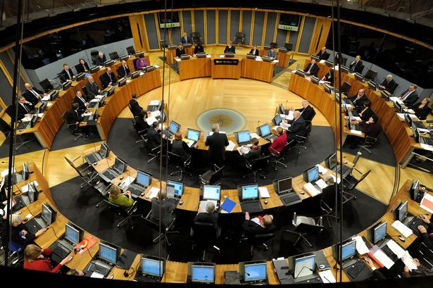
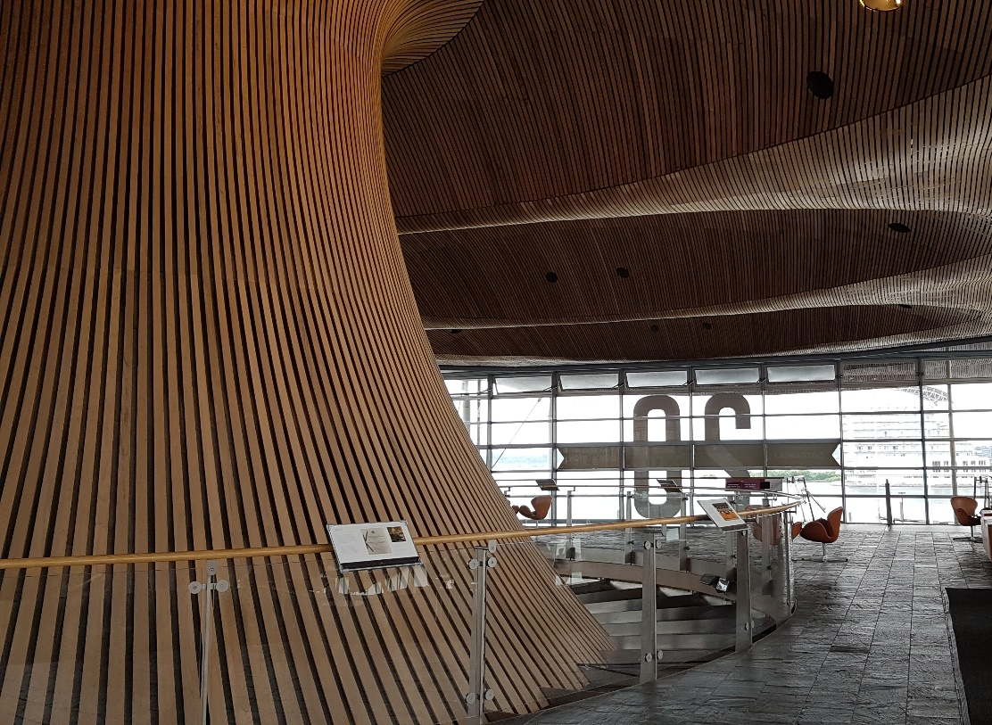
First referendum about more self-government in 1979 => NO
But in the 80s: Thatcherism + environmental pbs
=> September 1997: referendums in Scotland and Wales on devolution of powers (Wales: 50,3% YES)
Devolution = some level of political and legislative autonomy through decentralisation
Scottish Parliament and a National Assembly for Wales
Government of Wales Act 1998
M. Bourdeau UJML3 2020-2021

Slide 22

Senedd Cymru (Welsh Parliament)
Before May 2020: called the National Assembly for Wales
/Cynulliad Cenedlaethol Cymru
Unicameral
60 Assembly Members (AMs)
Elections every 5 years
UK Parliament remains sovereign
Mostly secondary legislation (= adapting laws, not initiating them)
Government of Wales Act 2006: introduced limited primary legislation
March 2011 referendum: direct law-making powers
Only 20 devolved subjects; the rest are ‘reserved matters’ (Westminster only)
M. Bourdeau UJML3 2020-2021

Slide 23
What powers are devolved?
What powers are not devolved? (The UK government is responsible for national policy on all powers which have not been devolved)
MAJOR DEVOLVED POWERS
WALES
Agriculture, forestry & fishing
Education
Environment
Health & social welfare
Housing
Local government
Fire & rescue services
Highways & transport
Economic development
MAJOR NON-DEVOLVED POWERS
WALES
Defence & national security
Economic policy
Foreign policy
Energy
Immigration & nationality
M. Bourdeau UJML3 2020-2021

Slide 24
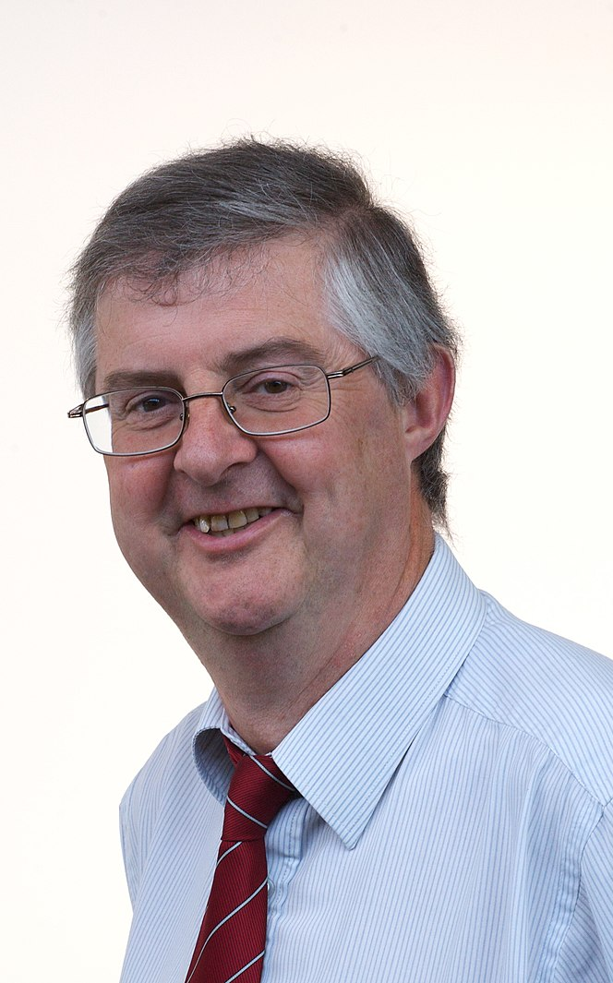
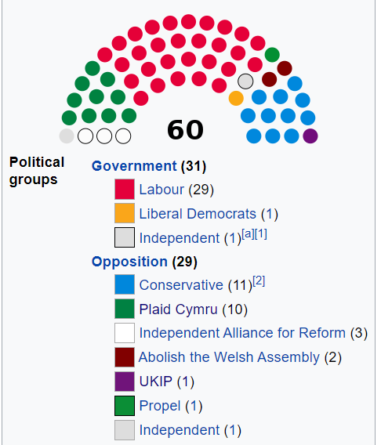
Current Senedd composition (since 2016 & until May 2021):
M. Bourdeau UJML3 2020-2021
Current First Minister of Wales =
Mark Drakeford (Labour)

Slide 25

Political parties :
Labour (current majority)
Conservative Party
Green Party
Plaid Cymru
/ˌplaɪd ˈkʌmri/
Created in 1925; first seat in Parliament in 1966
Pro-Welsh independence from the UK
Social-democratic
Pro-European
M. Bourdeau UJML3 2020-2021

Slide 26
Devolution = a success? Mitigated.
Closing the GDP gap with England: aim but unachieved
Number of people in work = success: unemployment in Wales = 3.9% (much lower than the UK average)
Credit to the Welsh government or the UK government?
Welsh government= just one of several factors
UK government = raising taxes and determining welfare payments + Bank of England = monetary policy and interest rates
M. Bourdeau UJML3 2020-2021

Slide 27
Legal system: W & E still under one jurisdiction
Increasing divergence in law since devolution? More and more laws specific to Wales
lack of a separate Welsh legal system: constraining the development of democracy in Wales?
Assembly committee: in charge of examining the idea of breaking from the single, shared legal system
Unhappy English voters: no political or constitutional existence or representation for England
=> is the current political model viable (for both Wales & England)?
M. Bourdeau UJML3 2020-2021

